Slide 1


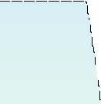
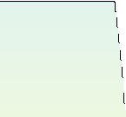
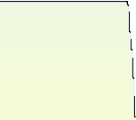
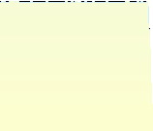
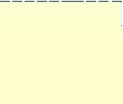
Assemblers
System Software by Leland L. Beck Chapter 2
1

Slide 2



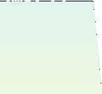
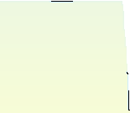
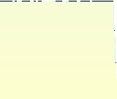
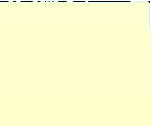
Role of Assembler
Source
Object
Assembler
Linker
Program
Code
Executable Code
Loader

Slide 3



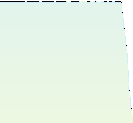
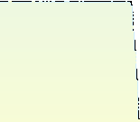
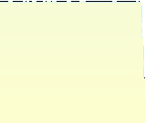
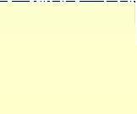
Chapter 2 -- Outline
Basic Assembler Functions
Machine-dependent Assembler Features
Machine-independent Assembler Features
Assembler Design Options

Slide 4



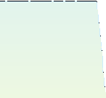
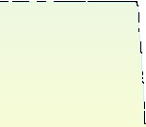
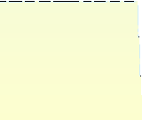
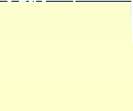
Introduction to Assemblers
Fundamental functions
translating mnemonic operation codes to their machine language equivalents
assigning machine addresses to symbolic labels
Machine dependency
different machine instruction formats and codes

Slide 5


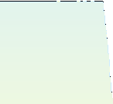
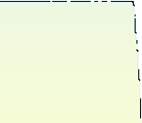
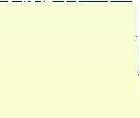
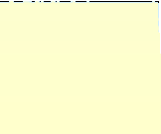
Example Program (Fig. 2.1)
Purpose
reads records from input device (code F1)
copies them to output device (code 05)
at the end of the file, writes EOF on the output device, then RSUB to the operating system

Slide 6
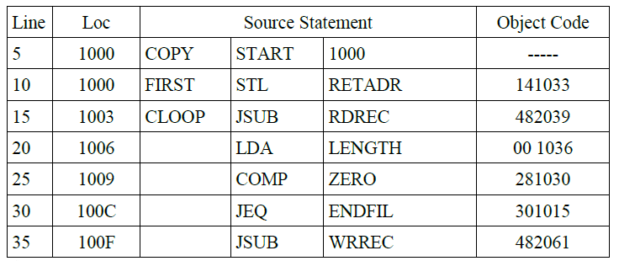
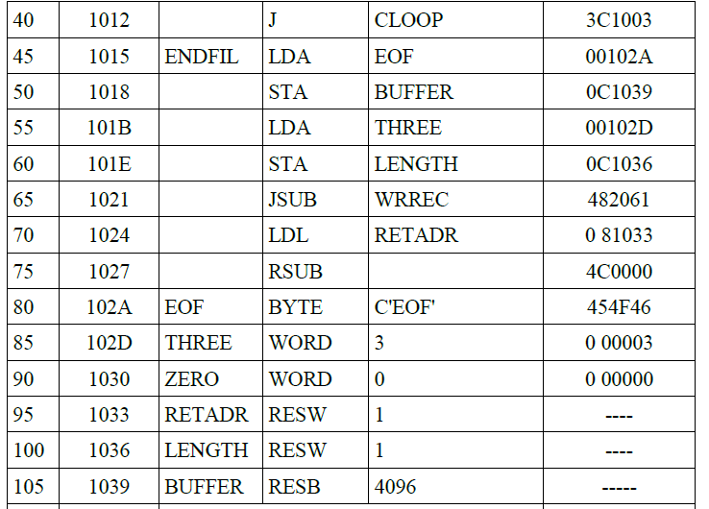

Slide 7
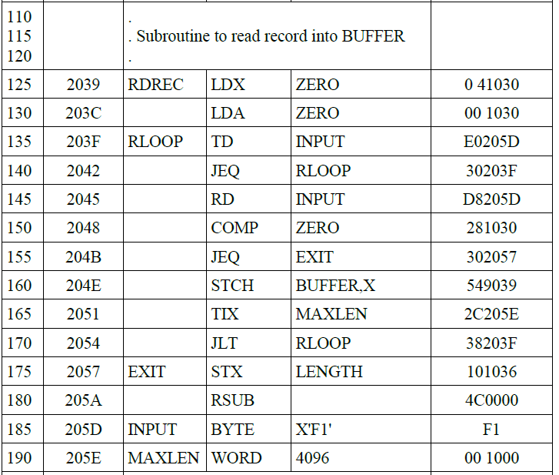

Slide 8
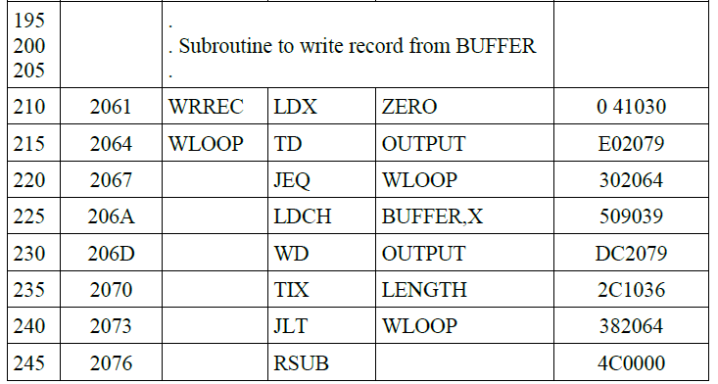


Slide 9



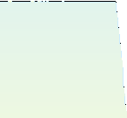
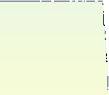
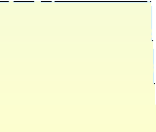
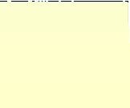
Example Program (Fig. 2.1)
Data transfer (RD, WD)
a buffer is used to store record
buffering is necessary for different I/O rates
the end of each record is marked with a null character (00₁₆)
the end of the file is indicated by a zero-length record
Subroutines (JSUB, RSUB)
RDREC, WRREC
save link register first before nested jump

Slide 10


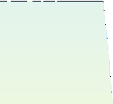
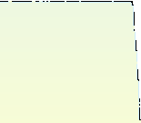
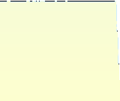
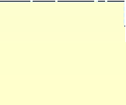
Assembler Directives
Pseudo-Instructions
Not translated into machine instructions
Providing information to the assembler
Basic assembler directives
START
END
BYTE
WORD
RESB
RESW

Slide 11



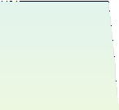
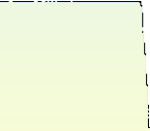
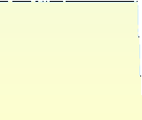
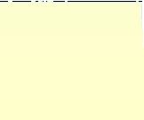
Assembler’s functions
Convert mnemonic operation codes to their machine language equivalents
Convert symbolic operands to their equivalent machine addresses ✓
Build the machine instructions in the proper format
Convert the data constants to internal machine representations
Write the object program and the assembly listing

Slide 12


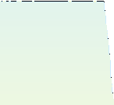
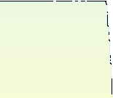
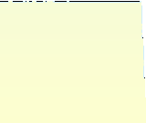

Example of Instruction Assemble
STCH
BUFFER,X
549039
8
1
15
opcode | x | address
m
(54)₁₆ 1 (001)₂
Forward reference
(039)₁₆

Slide 13

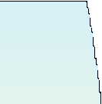
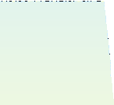
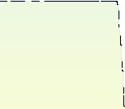
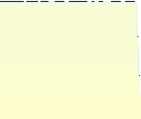
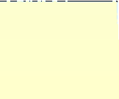
Difficulties: Forward Reference
Forward reference: reference to a label that is defined later in the program.
Loc Label Operator Operand
1000 FIRST STL RETADR
1003 CLOOP
… …
1012
… …
1033 RETADR
JSUB
… J
… RESW
RDREC
… CLOOP
… 1
…
…

Slide 14



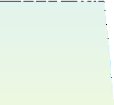
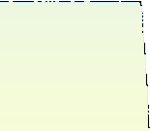
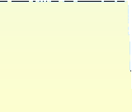
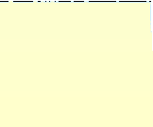
Two Pass Assembler
Pass 1
Assign addresses to all statements in the program
Save the values assigned to all labels for use in Pass 2
Perform some processing of assembler directives
Pass 2
Assemble instructions
Generate data values defined by BYTE, WORD
Perform processing of assembler directives not done in Pass 1
Write the object program and the assembly listing

Slide 15



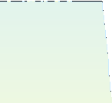



Two Pass Assembler
Read from input line
LABEL, OPCODE, OPERAND
Source program
Intermediate
Object
Pass 1
Pass 2
file
codes
OPTAB
SYMTAB
SYMTAB

Slide 16







Data Structures
Operation Code Table (OPTAB)
Symbol Table (SYMTAB)
Location Counter(LOCCTR)

Slide 17







OPTAB (operation code table)
Content
menmonic, machine code (instruction format, length) etc.
Characteristic
static table
Implementation
array or hash table, easy for search

Slide 18







SYMTAB (symbol table)
Content
COPY
1000
1000
1003
1015
label name, value, flag, (typ ^{FIRST}
e, length) etc.
CLOOP ENDFIL
Characteristic
dynamic table (insert, delet
Implementation
EOF THREE ZERO
1024
102D
1030
e, search)
RETADR
1033
hash table, non-random key LENGTH
1036 n
s, hashing functio
BUFFER RDREC
1039
2039

Slide 19






Object Program
Header Col. 1 Col. 2~7
H
Program name
Col. 8~13 Starting address (hex)
Col. 14-19 Length of object program in bytes (hex)
Text
Col.1 Col.2~7 Col. 8~9
T
Starting address in this record (hex)
Length of object code in this record in bytes (hex)
Col. 10~69Object code (69-10+1)/6=10 instructions
End
Col.1 Col.2~7
E
Address of first executable instruction (hex)
(END program_name)

Slide 20







Fig. 2.3
H COPY 001000 00107A
T 001000 1E 141033 482039 001036 281030 301015 482061 ...
T 00101E 15 0C1036 482061 081044 4C0000 454F46 000003 000000
T 002039 1E 041030 001030 E0205D 30203F D8205D 281030 …
T 002057 1C 101036 4C0000 F1 001000 041030 E02079 302064 …
T 002073 07 382064 4C0000 05
E 001000

Slide 21








Homework #1
SUM | START | 4000
FIRST | LDX | ZERO
 | LDA | ZERO
LOOP | ADD | TABLE,X
 | TIX | COUNT
 | JLT | LOOP
 | STA | TOTAL
 | RSUB
TABLE | RESW | 2000
COUNT | RESW | 1
ZERO | WORD | 0
TOTAL | RESW | 1
 | END | FIRST

Slide 22






Assembler Design
Machine Dependent Assembler Features
instruction formats and addressing modes
program relocation
Machine Independent Assembler Features
literals
symbol-defining statements
expressions
program blocks
control sections and program linking

Slide 23



Slide 24





Slide 25


Slide 26



Slide 27



Slide 28


Slide 29







Machine-dependent
Assembler Features
Sec. 2-2
Instruction formats and addressing modes
Program relocation
20

Slide 30







Instruction Format and Addressing Mode
SIC/XE
PC-relative or Base-relative addressing:
Indirect addressing:
Immediate addressing:
Extended format:
Index addressing:
register-to-register instructions
op m op @m op #c
+op m op m,x
larger memory -> multi-programming (program allocation)
Example program
Figure 2.5

Slide 31






Translation
Register translation
register name (A, X, L, B, S, T, F, PC, SW) and their values (0,1, 2, 3, 4, 5, 6, 8, 9)
preloaded in SYMTAB
Address translation
Most register-memory instructions use program counter relative or base relative addressing
Format 3: 12-bit address field
base-relative: 0~4095
pc-relative: -2048~2047
Format 4: 20-bit address field

Slide 32






PC-Relative Addressing Modes
PC-relative
10 0000
FIRST STL
RETADR
17202D
op(6) | n | I | x | b | p | e | disp(12)
(14)₁₆ 1 1 0 0 1 0 (02D) ₁₆
displacement= RETADR - PC = 30-3 = 2D
40 0017 J CLOOP 3F2FEC
(3C)₁₆ 1 1 0 0 1 0 (FEC) ₁₆
displacement= CLOOP-PC= 6 - 1A= -14= FEC
op(6) | n | I | x | b | p | e | disp(12)

Slide 33







Base-Relative Addressing Modes
Base-relative
base register is under the control of the programmer
12 LDB #LENGTH
13
160 104E
BASE LENGTH STCH BUFFER, X
57C003
op(6) | n | I | x | b | p | e | disp(12)
( 54 )₁₆
(54)
1 1 1 1 0 0 ( 003 ) ₁₆
1 1 1 0 1 0 0036-1051= -101B
displacement= BUFFER - B = 0036 - 0033 = 3
NOBASE is used to inform the assembler that the contents of the base register no longer be relied upon for addressing

Slide 34







Immediate Address Translation
Immediate addressing
55 0020 LDA #3
( 00 )₁₆ 0 1 0 0 0 0
133 103C +LDT ( 74 )₁₆ 0 1 0 0 0 1
010003
op(6) | n | I | x | b | p | e | disp(12)
( 003 ) ₁₆
#4096
75101000
op(6) | n | I | x | b | p | e | disp(20)
( 01000 ) ₁₆

Slide 35







Immediate Address Translation (Cont.)
Immediate addressing
12 0003
LDB #LENGTH
69202D
op(6) | n | I | x | b | p | e | disp(12)
( 68)₁₆ | 0 1 0 0 1 0 | ( 02D ) ₁₆
( 68)₁₆ | 0 1 0 0 0 0 | ( 033)₁₆ | 690033
the immediate operand is the symbol LENGTH
the address of this symbol LENGTH is loaded into register B
LENGTH=0033=PC+displacement=0006+02D
if immediate mode is specified, the target address becomes the operand

Slide 36







Indirect Address Translation
Indirect addressing
target addressing is computed as usual (PC- relative or BASE-relative)
only the n bit is set to 1
70 002A J @RETADR 3E2003
op(6) | n | I | x | b | p | e | disp(12)
( 3C )₁₆ 1 0 0 0 1 0
TA=RETADR=0030
( 003 ) ₁₆
TA=(PC)+disp=002D+0003

Slide 37







Program Relocation
Example Fig. 2.1
Absolute program, starting address 1000
e.g. 55 101B LDA THREE 00102D
Relocate the program to 2000
e.g. 55 101B LDA THREE 00202D
Each Absolute address should be modified
Example Fig. 2.5:
Except for absolute address, the rest of the instructions need not be modified
not a memory address (immediate addressing)
PC-relative, Base-relative
The only parts of the program that require modification at load time are those that specify direct addresses

Slide 38


Slide 39













Example

Slide 40





Relocatable Program
Modification record
Col 1 M
Col 2-7 Starting location of the address field to be modified, relative to the beginning of the program
Col 8-9 length of the address field to be modified, in half- bytes

Slide 41








Object Code

Slide 42







Machine-Independent Assembler
Features
Literals
Symbol Defining Statement Expressions
Program Blocks
Control Sections and Program Linking
32

Slide 43







Literals
Design idea
Let programmers to be able to write the value of a constant operand as a part of the instruction that uses it.
This avoids having to define the constant elsewhere in the program and make up a label for it.
Example
e.g. 45 001A ENDFILLDA =C’EOF’ 032010
93
002D *
LTORG
=C’EOF’
454F46
E32011
e.g. 215 1062
WLOOP
TD
=X’05’

Slide 44







Literals vs. Immediate Operands
Immediate Operands
The operand value is assembled as part of the machine instruction
e.g. 55 0020 LDA #3 010003
Literals
The assembler generates the specified value as a constant at some other memory location
e.g. 45 001A ENDFILLDA =C’EOF’ 032010
Compare (Fig. 2.6)
e.g. 45 | 001A | ENDFIL | LDA | EOF | 032010
80 | 002D | EOF | BYTE | C EOF | 454F46
’ ’

Slide 45







Literal - Implementation (1/3)
Literal pools
Normally literals are placed into a pool at the end of the program
see Fig. 2.10 (END statement)
In some cases, it is desirable to place literals into a pool at some other location in the object program
assembler directive LTORG
reason: keep the literal operand close to the instruction

Slide 46







Literal - Implementation (2/3)
Duplicate literals
e.g. 215 1062 WLOOP TD
e.g. 230 106B WD
=X 05
’ ’
=X’05’
The assemblers should recognize duplicate literals and store only one copy of the specified data value
Comparison of the defining expression
Same literal name with different value, e.g. LOCCTR=*
Comparison of the generated data value
The benefits of using generate data value are usually not great enough to justify the additional complexity in the assembler

Slide 47







Literal - Implementation (3/3)
LITTAB
literal name, the operand value and length, the address assigned to the operand
Pass 1
build LITTAB with literal name, operand value and length, leaving the address unassigned
when LTORG statement is encountered, assign an address to each literal not yet assigned an address
Pass 2
search LITTAB for each literal operand encountered
generate data values using BYTE or WORD statements
generate modification record for literals that represent an address in the program

Slide 48







Symbol-Defining Statements
Labels on instructions or data areas
the value of such a label is the address assigned to the statement
Defining symbols
symbol EQU value
value can be:  constant,  other symbol, 
expression
making the source program easier to understand
no forward reference

Slide 49







Symbol-Defining Statements
Example 1
MAXLEN
EQU 4096
+LDT #MAXLEN
◆
+LDT
#4096
Example 2
BASE EQU R1
COUNT EQU R2
R3
INDEX EQU
Example 3
MAXLEN
EQU BUFEND-BUFFER

Slide 50







ORG (origin)
Indirectly assign values to symbols
Reset the location counter to the specified value
ORG value
Value can be:  constant,  other symbol, 
expression
No forward reference
Example
SYMBOL: 6bytes
VALUE: 1word
FLAGS: 2bytes
LDA VALUE, X
 | SYMBOL | VALUE | FLAGS
STAB
(100 entries)
 | . | . | .
 | . | . | .
 | . | . | .

Slide 51







ORG Example
Using EQU statements
STAB RESB 1100
SYMBOL EQU STAB
VALUE EQU
STAB+6 STAB+9
FLAG EQU
Using ORG statements
STAB RESB 1100
◆
ORG STAB
RESB 6
SYMBOL
VALUE RESW 1
FLAGS RESB 2
◆
ORG STAB+1100

Slide 52






Expressions
Expressions can be classified as absolute expressions or relative expressions
MAXLEN EQU BUFEND-BUFFER
BUFEND and BUFFER both are relative terms, representing addresses within the program
However the expression BUFEND-BUFFER represents an absolute value
When relative terms are paired with opposite signs, the dependency on the program starting address is canceled out; the result is an absolute value

Slide 53







SYMTAB
None of the relative terms may enter into a multiplication or division operation
Errors:
BUFEND+BUFFER
100-BUFFER
3*BUFFER
The type of an expression
keep track of the types of all symbols defined in the program
Symbol | Type | Value
RETADR | R | 30
BUFFER | R | 36
BUFEND | R | 1036
MAXLEN | A | 1000

Slide 54







Example 2.9
SYMTAB
Name | Value
COPY | 0
FIRST | 0
CLOOP | 6
ENDFIL | 1A
RETADR | 30
LENGTH | 33
BUFFER | 36
BUFEND | 1036
MAXLEN | 1000
RDREC | 1036
RLOOP | 1040
EXIT | 1056
INPUT | 105C
WREC | 105D
WLOOP | 1062
LITTAB
C'EOF' | 454F46 | 3 | 002D
X'05' | 05 | 1 | 1076

Slide 55






Program Blocks
Program blocks
refer to segments of code that are rearranged within a single object program unit
USE [blockname]
At the beginning, statements are assumed to be part of the unnamed (default) block
If no USE statements are included, the entire program belongs to this single block
Example: Figure 2.11
Each program block may actually contain several separate segments of the source program

Slide 56







Program Blocks - Implementation
Pass 1
each program block has a separate location counter
each label is assigned an address that is relative to the start of the block that contains it
at the end of Pass 1, the latest value of the location counter for each block indicates the length of that block
the assembler can then assign to each block a starting address in the object program
Pass 2
The address of each symbol can be computed by adding the assigned block starting address and the relative address of the symbol to that block

Slide 57







Figure 2.12
Each source line is given a relative address assigned and a block number
Block name | Block number | Address | Length
(default) | 0 | 0000 | 0066
CDATA | 1 | 0066 | 000B
CBLKS | 2 | 0071 | 1000
For absolute symbol, there is no block number
line 107
Example
20 0006 0 LDA LENGTH 032060
LENGTH=(Block 1)+0003= 0066+0003= 0069
LOCCTR=(Block 0)+0009= 0009

Slide 58






Program Readability
Program readability
No extended format instructions on lines 15, 35, 65
No needs for base relative addressing (line 13, 14)
LTORG is used to make sure the literals are placed ahead of any large data areas (line 253)
Object code
It is not necessary to physically rearrange the generated code in the object program
see Fig. 2.13, Fig. 2.14

Slide 59







Control Sections and Program Linking
Control Sections
are most often used for subroutines or other logical subdivisions of a program
the programmer can assemble, load, and manipulate each of these control sections separately
instruction in one control section may need to refer to instructions or data located in another section
because of this, there should be some means for linking control sections together
Fig. 2.15, 2.16

Slide 60







External Definition and References
External definition
EXTDEF name [, name]
EXTDEF names symbols that are defined in this control section and may be used by other sections
External reference
EXTREF name [,name]
EXTREF names symbols that are used in this control section and are defined elsewhere
Example
15 | 0003 CLOOP | +JSUB | RDREC 4B100000
160 | 0017 | +STCH | BUFFER,X 57900000
190 | 0028 MAXLEN | WORD | BUFEND-BUFFER 000000

Slide 61







Implementation
The assembler must include information in the object program that will cause the loader to insert proper values where they are required
Define record
Col. 1 D
Col. 2-7 Name of external symbol defined in this control section
Col. 8-13 Relative address within this control section (hexadeccimal)
Col.14-73 Repeat information in Col. 2-13 for other external symbols
Refer record
Col. 1 R
Col. 2-7 Name of external symbol referred to in this control section
Col. 8-73 Name of other external reference symbols

Slide 62







Modification Record
Modification record
Col. 1 M
Col. 2-7 Starting address of the field to be modified (hexiadecimal)
Col. 8-9 Length of the field to be modified, in half-bytes (hexadeccimal)
Col.11-16 External symbol whose value is to be added to or subtracted from the indicated field
Note: control section name is automatically an external symbol,
i.e. it is available for use in Modification records.
Example
Figure 2.17
M00000405+RDREC
M00000705+COPY

Slide 63







External References in Expression
Earlier definitions
required all of the relative terms be paired in an expression (an absolute expression), or that all except one be paired (a relative expression)
New restriction
Both terms in each pair must be relative within the same control section
Ex: BUFEND-BUFFER
Ex: RDREC-COPY
In general, the assembler cannot determine whether or not the expression is legal at assembly time. This work will be handled by a linking loader.

Slide 64





Assembler Design Options
One-pass assemblers Multi-pass assemblers
Two-pass assembler with overlay structure
54

Slide 65







Two-Pass Assembler with Overlay Structure
For small memory
pass 1 and pass 2 are never required at the same time
three segments
root: driver program and shared tables and subroutines
pass 1
pass 2
tree structure
overlay program

Slide 66







One-Pass Assemblers
Main problem
forward references
data items
labels on instructions
Solution
data items: require all such areas be defined before they are referenced
labels on instructions: no good solution

Slide 67



Slide 68


Slide 69


Slide 70







One-Pass Assemblers
Main Problem
forward reference
data items
labels on instructions
Two types of one-pass assembler
load-and-go
produces object code directly in memory for immediate execution
the other
produces usual kind of object code for later execution
Forward references are written as part of a TEXT RECORD in object program.
This correct operand address will be inserted into instruction by loader at load time.

Slide 71

Address of ENDFIL
When program is loaded 2024 will replace previous 0000.
Other forward references will be handled similar way.
Literals not allowed.
Only actual (not relative) addresses in operands.

Slide 72






Load-and-go Assembler
Characteristics
Useful for program development and testing
Avoids the overhead of writing the object program out and reading it back
Both one-pass and two-pass assemblers can be designed as load-and-go.
However one-pass also avoids the over head of an additional pass over the source program
For a load-and-go assembler, the actual address must be known at assembly time, we can use an absolute program

Slide 73







Forward Reference in One-pass Assembler
For any symbol that has not yet been defined
omit the address translation
insert the symbol into SYMTAB, and mark this symbol undefined
the address that refers to the undefined symbol is added to a list of forward references associated with the symbol table entry
when the definition for a symbol is encountered, the proper address for the symbol is then inserted into any instructions previous generated according to the forward reference list

Slide 74







Load-and-go Assembler (Cont.)
At the end of the program
any SYMTAB entries that are still marked with * indicate undefined symbols
search SYMTAB for the symbol named in the END statement and jump to this location to begin execution
The actual starting address must be specified at assembly time
Example
Figure 2.18, 2.19

Slide 75







Producing Object Code
When external working-storage devices are not available or too slow (for the intermediate file between the two passes
Solution:
When definition of a symbol is encountered, the assembler must generate another Tex record with the correct operand address
The loader is used to complete forward references that could not be handled by the assembler
The object program records must be kept in their original order when they are presented to the loader
Example: Figure 2.20

Slide 76






Multi-Pass Assemblers
Restriction on EQU and ORG
no forward reference, since symbols’ value can’t be defined during the first pass
Example
Use link list to keep track of whose value depend on an undefined symbol
Figure 2.21

Slide 77

Solution – Forward reference portions are saved in pass 1.
Additional passes add these informations

Slide 78


